Slide 1
Modeling customer groups with random forests
For a restaurant… somewhere

Slide 2
Background
A restaurant is hosting a series of wine dinners, and is ready to promote upcoming dinners.
Who should get promotions for the dinners?
Goals:
Avoid promoting to people who don’t care – not all guests are interested (because of cost)
Promote to as many people as are likely to book, because the dinners drive so much revenue per ticket

Slide 3
The method
Random Forest
modeling
Use the ~250 guests who have already booked to predict who’s likely to book
Features for modeling include:
All-time reservation count
Total spend
Reservations at different meal periods
Email opt-in
Reservation system tags (“wine lover”, etc)

Slide 4
Challenges & solutions
Accuracy, sensitivity & class imbalance
Because only 0.3% of the dataset were prior attendees, initial models prioritized non-attendees
Accuracy was great (>99%), but sensitivity was 0% - meaning model never predicted someone would attend
How did I fix it?
Random forest model
Undersampling the non-attendees
Setting probability threshold for class membership

Slide 5
The result?
A model that predicts wine dinner attendees with 80% accuracy, and 83% sensitivity!

Slide 6
The process in depth
Decision tree → Random forest → Refinements

Slide 7
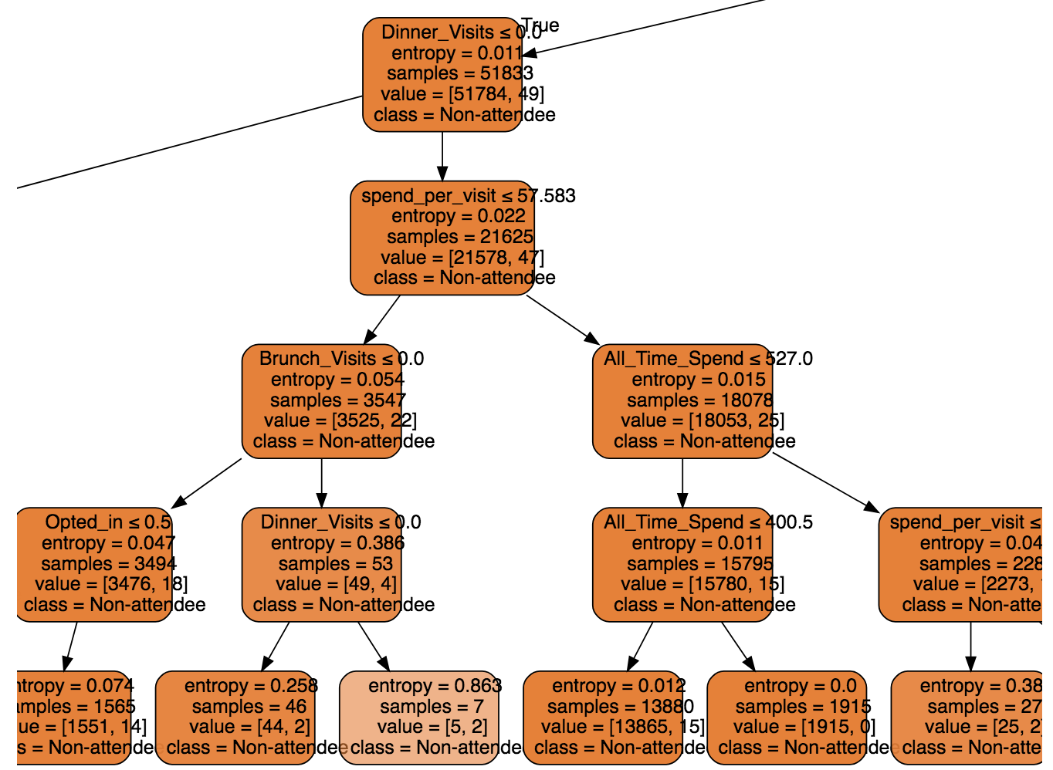
Decision tree
Initial attempts produced heinous decision trees
Accuracy was high, but the model was just predicting that nobody would be an attendee
Also totally illegible
#yeesh

Slide 8
Random forest
Random forest modeling improved sensitivity to ~20%, but hyperparameter tuning on number of estimators didn’t drive improvement
Not a solution by itself
#stillyeesh

Slide 9
Probability thresholds
Instead of letting the random forest vote on a binary class membership, I set a probability threshold for class membership
More relaxed thresholds increased the sensitivity…
…but still maxed out around 75% …
…and 10% threshold isn’t much of a model

Slide 10
Undersampling
After doing some research, I discovered that the general model crumminess was probably (in part) due to class imbalance
The solution? Undersample the majority class (non-attendees)
Train the model on subset of the data, with equal numbers of attendees and non-attendees

Slide 11
Bringing it all together
Iterating through different thresholds for predicting class membership, the new model performed best at around 60% threshold:
Accuracy: 81%
Sensitivity: 84%

Slide 12
And out in the wild…
The model was built using features that we can’t easily pull. What happens if we fit it using only easily-pulled features?
Even without threshold tweaks – model fit on fewer features performs almost as well as full model
So, we can let this bad boy loose!

